Slide 1
ME759 High Performance Computing for Applications in Engineering [Spring 2020]
Lecture 11
02/17/2019
Dan Negrut, 2020 ME759 UW-Madison

Slide 2
Quote of the day
“Computer science is no more about computers than astronomy is about telescopes”
-- Edsger W. Dijkstra, Dutch systems scientist, programmer, software engineer, science essayist, and pioneer in computing science [ [1930-2002].

Slide 3
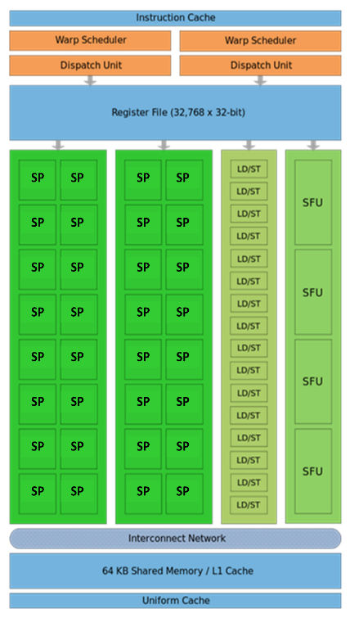
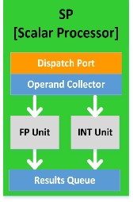
Before we get going…
Last time:
More on execution configuration
GPU “scheduling for execution” issues
Today:
Wrap up, scheduling for execution on the GPU
The GPU memory ecosystem
Other tidbits:
Assignment due on Friday at 9 pm
Anonymous feedback: https://forms.gle/ZUCbyKX87mJvK61M7

Slide 4
Execution Scheduling Issues
Notes:
Understanding execution scheduling is important for performance (effectively using the hardware).
Knowing the underlying hardware is also important on the CPU (e.g. being aware of caching – as we will see in the OpenMP section). However, the compiler and tool development on the GPU is much more recent and more is left to the developer.

Slide 5
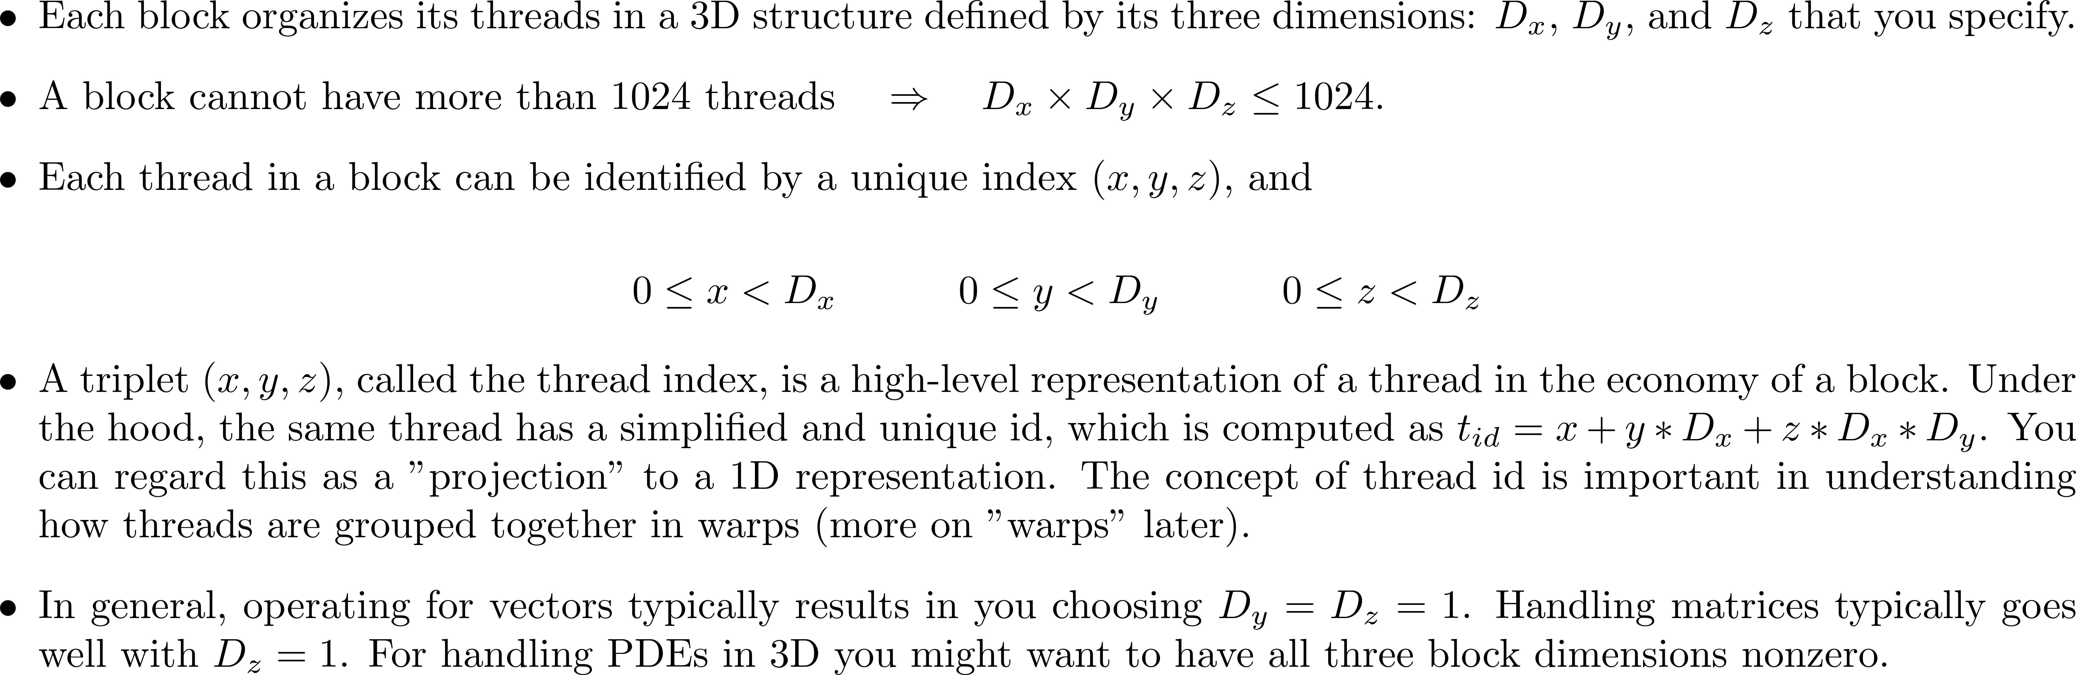
[short/important topic]: Thread Index vs. Thread ID [critical in ($i$) understanding how SIMD is supported in CUDA, and ($ii$) understanding the concept of “warp”]
Notes:
Thread indices are a convenience to the programmer.
The actual threads are organized in a single, linear array of IDs.
This concept also very important in how threads are organized into warps.
Warps are important because the threads in a warp proceed in lock-step fashion (implications to thread divergence, etc.). Warps are the quantum unit of scheduling on an SM.
The index that runs faster is x, next y, slowest z.
For thread with thread index (4,2,3), the next one (for scheduling purposes) is thread with index (5,2,3)! Not (4,2,4)

Slide 6
Thread Execution Scheduling
Starting point observation:
You launch on the device many blocks, each containing many threads
Questions in this segment:
In which order are these blocks executed?
How is this execution process managed?
When/How are the threads in a block executed?
Etc…
Notes:
Two relevant questions...
For larger problems you must launch multiple blocks (because of the 1024 thread/block limit). So how is a kernel split over multiple blocks executed?
For this discussion, recall the mapping between thread index and thread ID. At the end of the day, the SM’s scheduler sees the threads in a block based on their ID (i.e. a one-dimensional array: 0,1,2,…)

Slide 7
High-level Perspective
There are two schedulers at work in GPU computing
A device-level scheduler: assigns blocks to SM that indicate at a given time “excess capacity”
This scheduler called by NVIDIA the “GigaThread engine”
An SM-level scheduler: schedules the execution of the threads in a block onto the SM functional units
This is the more interesting scheduler
Notes:
We’ll talk more about the SM-level scheduler as it is more interesting and important

Slide 8
Device-Level Scheduler
Grid is launched on the device
Thread Blocks are distributed to the SMs
Potentially more than one block per SM
There is a limit on the number of blocks an SM can take.
As Thread Blocks complete kernel execution, resources are freed
Device-level scheduler can launch next block(s) in line
This is the first levels of scheduling:
For running [desirably] a large number of blocks (thousands) on a relatively small number of SMs (60/16/14/etc.)
Limits, for resident blocks/SM:
32 blocks on the Maxwell SM, Pascal SM, and Volta SM
16 blocks can be resident on a Kepler SM
8 blocks can be resident on a Fermi & Tesla SM
Host
Device
Grid 1
Kernel 1
Block
(0, 0)
Block
(1, 0)
Block
(2, 0)
Block
(0, 1)
Block
(1, 1)
Block
(2, 1)
Grid 2
Kernel 2
Block (1, 1)
Thread
(0, 0)
Thread
(1, 0)
Thread
(2, 0)
Thread
(3, 0)
Thread
(4, 0)
Thread
(0, 1)
Thread
(1, 1)
Thread
(2, 1)
Thread
(3, 1)
Thread
(4, 1)
Thread
(0, 2)
Thread
(1, 2)
Thread
(2, 2)
Thread
(3, 2)
Thread
(4, 2)
Notes:
Device-level schedules blocks for execution.
You cannot rely on order of block execution or assignment of blocks over SMs.
You can have 8 (Fermi) or 16 (Kepler) or 32 (recent) blocks resident on an SM

Slide 9
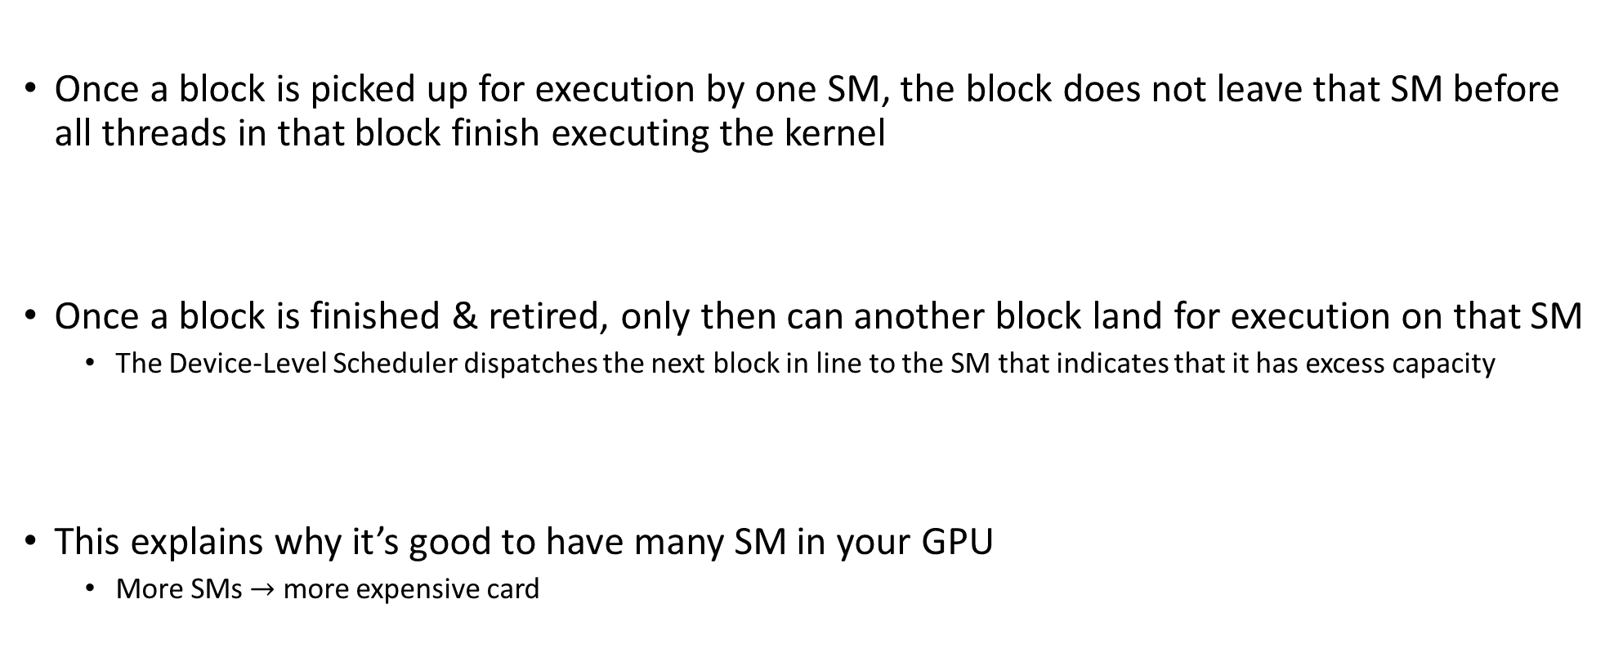
Device-Level Scheduler, Comments
Once a block is picked up for execution by one SM, the block does not leave that SM before all threads in that block finish executing the kernel
Once a block is finished & retired, only then can another block land for execution on that SM
The Device-Level Scheduler dispatches the next block in line to the SM that indicates that it has excess capacity
This explains why it’s good to have many SM in your GPU
More SMs $→$ more expensive card

Slide 10
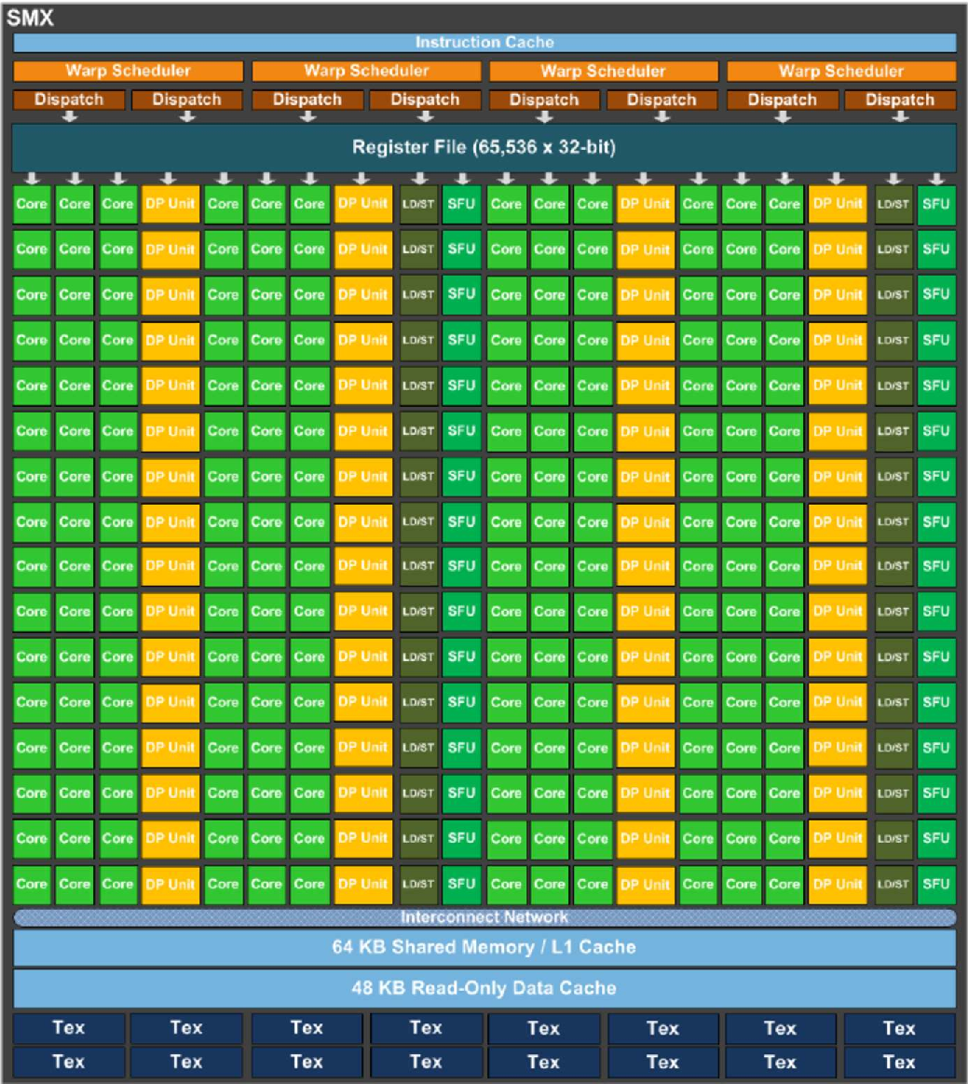
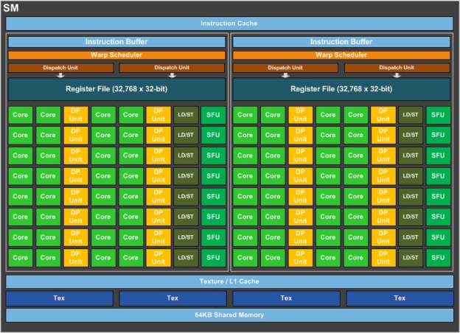
More Recent SM Generations
Volta SM
Maxwell SMX
Pascal SM
Motivated by AI & Machine Learning
Notes:
Pascal architecture indicates a move to a simpler datapath that requires less die area and lower power requirements.
But performance was not affected: smarter schedulers!
For example, Pascal can issue 32-bit operations (double precision) in a cycle.

Slide 11
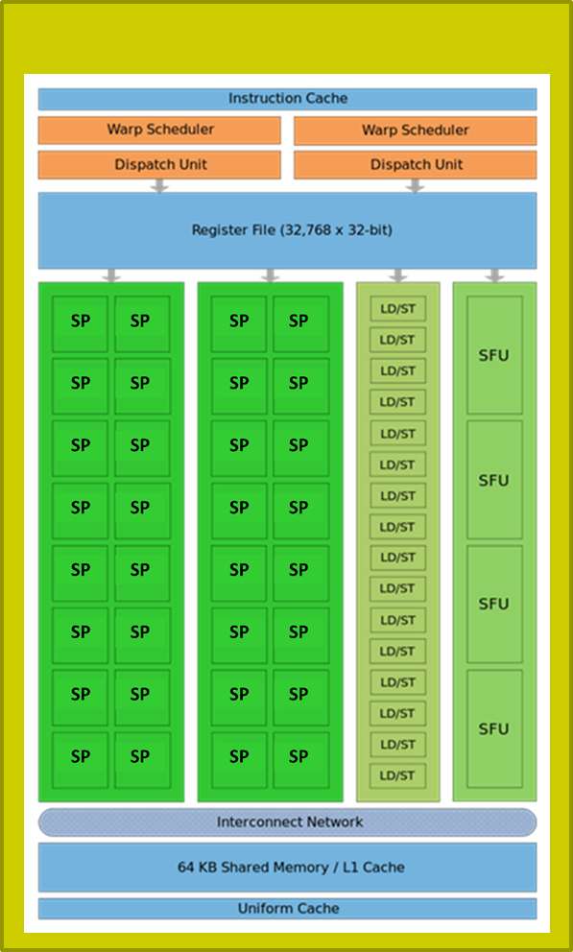
SM-Level Schedulers
…
…
Block 1 Warps
Block 2 Warps
…
…
t0 t1 t2 … t31
t0 t1 t2 … t31
Each block of threads divided in 32-thread warps
“32”: selected by NVIDIA, programmer has no say
Warp: A group of 32 threads of consecutive IDs
Warps are the basic scheduling unit on the SM
Limits, number of resident warps on an SM:
64: on Kepler, Maxwell, Pascal, Volta (i.e., 2048 resident threads)
48: on Fermi (i.e., 1536 resident threads)
32: on Tesla (i.e., 1024 resident threads)
SP
SP
SP
11
Notes:
Assume 2 blocks with 256 threads each.
So you have 512 threads that must be executed on a small number of SPs (32 on Fermi, 64 on Pascal).
How do they get a chance to execution?
The SM has 2 warp schedulers. What gets scheduled for execution on an SM are warps. So we must deal with 16 warps from 2 blocks.
Scheduling is done based on scoreboarding: each warp gets a score based on whether or not they have everything needed to execute (e.g. all operands, required SFU). The schedulers work at ½ the frequency of the SPs.

Slide 12
Quiz
If 3 blocks are processed by an SM and each Block has 256 threads, how many warps are managed by the SM?
Each block of threads is divided into 256/32 = 8 warps
There are 8 * 3 = 24 warps
At any point in time, there are 24 warps that can be selected for execution

Slide 13
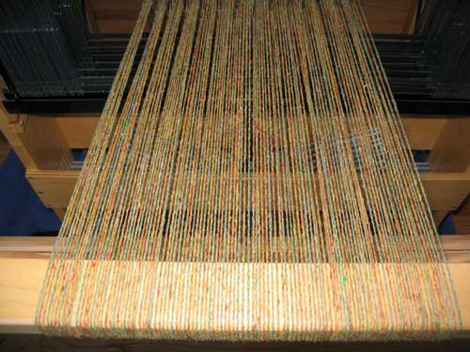
SM Warp Scheduling, more details
SM hardware implements almost zero-overhead Warp scheduling
Warps whose next instruction has its operands ready for consumption are eligible for execution
Eligible Warps are selected for execution on a prioritized scheduling policy
All threads in a Warp execute same instruction
SM multithreaded
Warp scheduler
time
warp 8 instruction 11
warp 1 instruction 42
warp 3 instruction 35
. . .
warp 8 instruction 12
warp 3 instruction 36
Notes:
Low overhead for changing context (unlike CPU)
This is because the context for each thread (e.g. registers) is already available (no need to pack/unpack this with the threads as done on the CPU).
Important to have many warps on an SM: better chance to find one that’s ready to be executed.
Note: on old cards (Tesla) there were only 8 SPs and one scheduler: 4 cycles needed for one instruction (for one warp). Fermi has 2 schedulers and 2x16 SPs that work at twice the frequency of the schedulers → 1 instruction / cycle
This information is important because it can tell you how many warps are needed (for a particular code) to hide memory access latencies with useful computations. In this example: 34 warps minimum.
High arithmetic intensity → fewer warps needed to hide latencies.

Slide 14
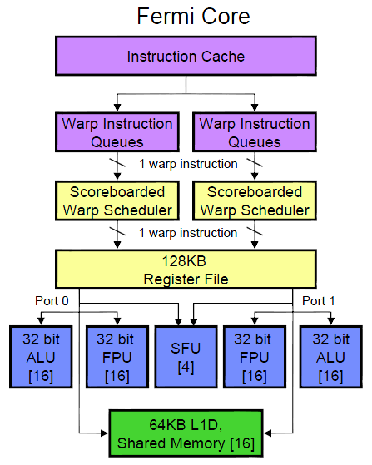
Fermi Specifics
There are two schedulers that issue warps of “ready-to-go” threads
One warp issued at each clock cycle by each scheduler
During no cycle can more than 2 warps be dispatched for execution on the SM’s functional units
Scoreboarding used to figure out which warp is ready
Fermi SM
Notes:
4 function units:
16 ALU/FPU (integer/single precision)
16 ALU/FPU (integer/single precision)
4 SFU (for special mathematical functions)
16 LDST (load/store)
For double precision: both 1 and 2 are used
Scoreboarding looks at:
instructions being fetched/decoded
necessary resources (operands ready? SFU required?)
what instruction modifies what register
Two warps with same score are selected oldest-first

Slide 15
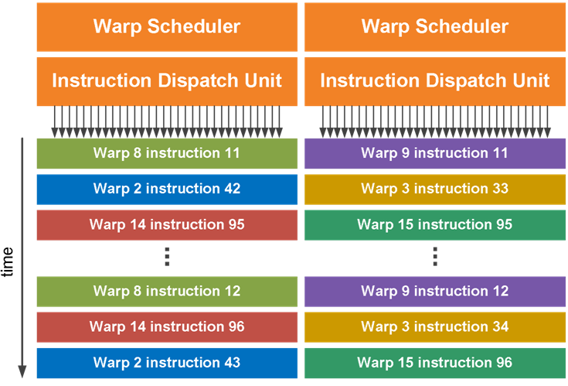
Quick Remarks
ILP support: relatively limited
GPU architecture is pipelined
At each clock cycle one instruction can be retired
Fermi has no out-of-order execution smarts
To the best of my knowledge
There is no prefetching
There is no speculative execution

Slide 16
Example, establishing Flop/s performance level: Fermi
Scheduler works at 607 MHz
Functional units work at 1215MHz
Question:
What is the peak flop rate of GTX480?
15 SMs * 32 SPs * 1215 * 2 (Fused Multiplied Add) = 1166400 Mflops
That is, 1.166 Tflops, single precision

Slide 17
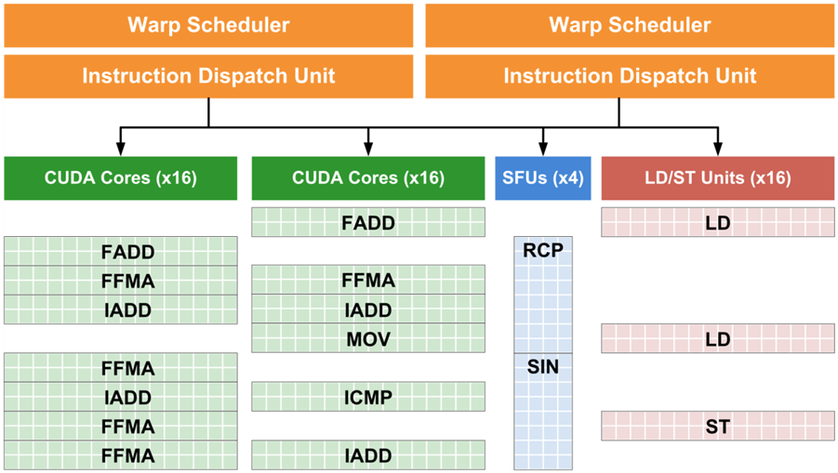
Fermi Specifics
As shown in picture, at no time can we see more than 2 warps being dispatched for execution during a cycle
Note that at any given time we might have more than two functional units working though (which is actually very good, device kept busy)
Present
T i m e
Past
Notes:
Because there are 2 schedulers: at most 2 instructions are dispatched for execution in a cycle.
But you can have more of them being executed at any given time! Indeed, an SFU for example needs 4 cycles to complete. Other warps that do not require them can be executing on other FUs (ALU, FPU, LDST)

Slide 18
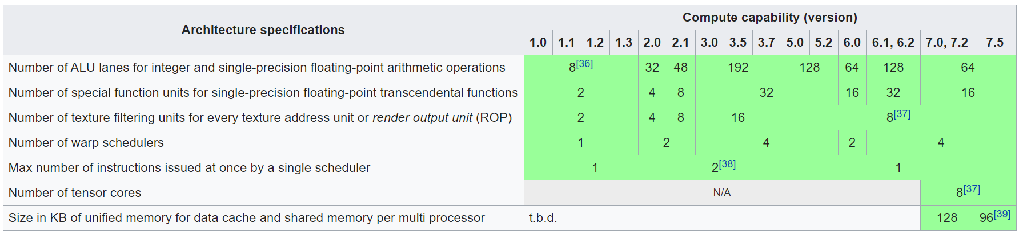
SM Architecture Specifications (data below refers to ONE SM)
Fermi
Kepler
Maxwell
Pascal
Volta
Turing
[Wikipedia]→
Notes:
Note: Volta will move back to 4 schedulers per SM
Pascal: compute capability 6.0

Slide 19
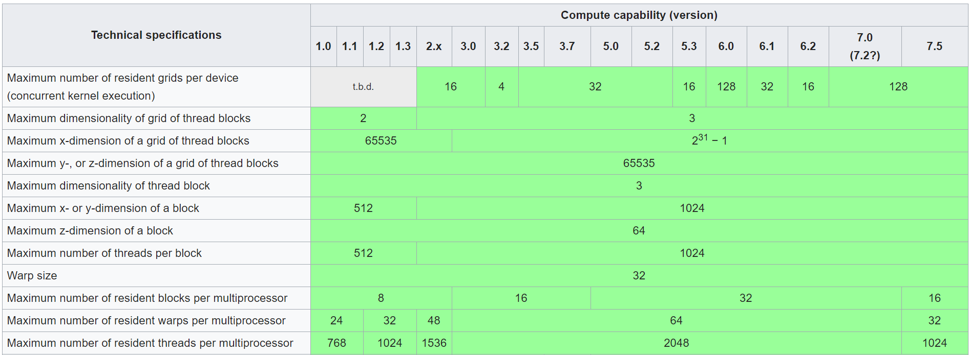
Technical Specifications and Features
[Wikipedia]→
Notes:
Recall: compute capability is an expression of the hardware generation.

Slide 20
Organizing Threads into Warps
Thread IDs within a warp are consecutive and increasing
Related to the 1D projection from thread index to thread ID
Recall: in multidimensional blocks, the x thread index runs fastest, then y, then z
Threads with IDs (0...31) combine into warp 0, threads (32…63) into warp 1, etc.
Partitioning of threads into warps is always the same
You can use this in control flow
Warp size has always been 32 and is unlikely to change soon
While you can rely on ordering among threads, DO NOT rely on any ordering among warps
Warp scheduling is not under user control in CUDA
Notes:
In other words, thread with ID 67 will always be in warp 2. You can use that!
(What you probably will use is that thread IDs 66 and 67 are in the same warp)
But you cannot count on, say, warp 1 to be always scheduled before warp 2!

Slide 21
Threads are Organized & Executed as Warps
Each thread block split into one or more warps
If thread block size is not multiple of warp size, unused lanes go wasted
Example: block w/ 50 threads – 64 lanes, of which last 14 lanes go wasted
The hardware schedules each warp independently
Warps within a thread block execute independently
Warp of 32 threads
Block of 128 threads
Warp of 32 threads
Warp of 32 threads
Warp of 32 threads
NVIDIA [J. Balfour]→
Notes:
A block of 128 threads, color-coded in 4 colors (4 warps).
The warps are scheduled as a unit.
It is not required to have the block size a multiple of 32, but it’s a good idea!

Slide 22
Why many warps in flight is a good thing
An SM can switch between warps with almost no overhead
Warps with instruction whose inputs are ready are eligible to execute, and will be considered when scheduling
When a warp is selected for execution, all [active] threads execute the same instruction in lockstep fashion
(pre-Volta; not anymore for Volta & Turing)
W₄
W_{n}
Executing W_{n}
W₃
Waiting for data
W₂
W₁
Ready to execute
[NVIDIA, J. Balfour]→
Notes:
Why is it good to have many warps?
If you need a memory transaction, these take hundreds of cycles.
You need eligible warps to be executed while others wait for data (white areas)
Hiding memory latency with useful computation
Note: more warps not always better!

Slide 23
Execution Configuration, revisiting the concept
Prefer thread block sizes that result in mostly full warps
Bad: kernel<<<N, 1>>> ( ... )
Okay: kernel<<<(N+31) / 32, 32>>>( ... )
Better: kernel<<<(N+127) / 128, 128>>>( ... )
Many threads per block provide SM with many warps to switch between
This is how the GPU hides memory access latency
Resource like amount of ShMem & size of RegFile may constrain number of threads per block
NVIDIA [J. Balfour]→
Notes:
Do not launch N blocks each with 1 thread!
OK, but not great, to have 32 threads in 1 block (that’s only 1 warp)
Best: Use 128, 256 threads/block
But maximum number of threads in a block is limited by shared memory (for example – see later). That would limit the number of blocks resident on an SM. This may reduce occupancy.
The moral of the story: algorithms may need to be changed for parallel computing, maybe to something that would be ridiculous to do on a sequential architecture!
We will see this on matrix multiplication with shared memory

Slide 24
Scheduling: Summing It Up…
When host invokes a kernel grid, the blocks of the grid are enumerated and distributed to SMs with available execution capacity
Number of resident blocks on one SM
Up to 8 blocks (on Fermi)
Up to 16 on Kepler & Turing
Up to 32 on Maxwell, Pascal, and Volta
When a block of threads is executed on an SM, its threads are grouped in warps. The SM manages several warps at the same time
Up to 48 warps can be managed by an SM on Fermi
Up to 64 warps can be managed on Kepler, Maxwell, Pascal, and Volta
Up to 32 warps can be managed on Turing
When a thread block finishes, a new block is launched on the vacated SM

Slide 25
Thread Divergence
[pre-Volta]
Notes:
New topic related to execution scheduling

Slide 26
Thread divergence issues
Consider the following code:
__global__ void odd_even(int n, int* x)
{
int i = threadIdx.x + blockDim.x * blockIdx.x;
if( (i & 0x01) == 0 )
{
x[i] = x[i] + 1;
}
else
{
x[i] = x[i] + 2;
}
}
Half the threads (even i) in the warp execute the if clause, the other half (odd i) the else clause
NVIDIA [J. Balfour]→
Notes:
0x01: all bits are 0 except the very least significant one.
When i is even, the “if” gets hit; when i is odd, the “else” side gets hit
Neighboring threads do different things → the threads inside a warp diverge
This requires two cycles: it’s as if the number of instructions was doubled

Slide 27
Thread Divergence in “if-then-else”
Handling of an if-then-else construct in CUDA
First, a subset of threads of the warp execute one branch
Execution moves forward for these threads in lockstep fashion
Next, the rest of the threads in the warp execute the other branch
Execution moves forward for these threads in lockstep fashion
After the if-then-else statement all threads of the warp move on in lockstep fashion

Slide 28
Thread divergence issues
The system automatically handles control flow divergence, conditions in which threads within a warp execute different paths through a kernel
Often, this requires that the hardware execute multiple paths through a kernel for a warp
For example, both the if clause and the corresponding else clause
NVIDIA [J. Balfour]→
Notes:
A switch statement may have similar effects.
This results in longer times required to advance the warp

Slide 29
Thread divergence issues
__global__ void kv(int* x, int* y)
{
int i = threadIdx.x + blockDim.x * blockIdx.x;
int t;
bool b = f(x[i]);
if( b )
{ // g(x)
t = g(x[i]);
}
else
{ // h(x)
t = h(x[i]));
}
y[i] = t;
}
NVIDIA [J. Balfour]→
Notes:
Some threads in the warp follow the if branch. The rest are idle.
Some threads in the warp follow the else branch. The rest are idle.

Slide 30
Thread divergence issues
Nested branches are handled similarly
Deeper nesting results in more threads being temporarily disabled
In general, one does not need to consider divergence when reasoning about the correctness of a program*
Certain code constructs, such as those involving schemes in which threads within a warp spin-wait on a lock, can cause deadlock
In general, one does need to consider divergence when reasoning about the performance of a program
NVIDIA calls execution model SIMT (Single Instruction Multiple Threads) to differentiate from actual SIMD where threads really are in lockstep
NVIDIA [J. Balfour]→
Notes:
You do not need to understand this to write code that runs correctly. The system handles this.
You need to worry about this for code that is performant.
Thread divergence is why NVIDIA calls their execution model SIMT. Subtle difference from SIMD: SIMT is SIMD for as long as the threads in a warp execute in lockstep mode; slightly different when threads diverge.

Slide 31
Performance of Divergent Code (1/2)
Performance decreases with degree of divergence in warps
Here’s an extreme example…
__global__ void dv(int* x)
{
int i = threadIdx.x + blockDim.x * blockIdx.x;
switch (i % 32)
{
case 0 : x[i] = a(x[i]);
break;
case 1 : x[i] = b(x[i]);
break;
...
case 31: x[i] = v(x[i]);
break;
}
}
NVIDIA [J. Balfour]→
Notes:
There are different levels of thread divergence.
This extreme example requires a minimum of 32 cycles.

Slide 32
Performance of Divergent Code (2/2)
Compiler and hardware can detect when all threads in a warp branch in the same direction
Example: all take the if clause, or all take the else clause
The hardware is optimized to handle these cases without loss of performance
if (threadIdx.x / WARP_SIZE >= 2) { }
Creates two different control paths for threads in a block
Branch granularity is a whole multiple of warp size; all threads in any warp follow the same path. No warp divergence…
The compiler can also compile short conditional clauses to use predicates (bits that conditionally convert instructions into null ops)
Avoids some branch divergence overheads and is more efficient
Often acceptable performance with short conditional clauses
NVIDIA [J. Balfour]→
Notes:
Note:
the presence of an if/else statement in a kernel function is not a problem by itself.
thread divergence concerns only divergence of threads within a warp!
Even for threads diverging inside a warp, in special situations (short sequences), the compiler can modify the code to remove thread divergence: all threads in a warp execute the same instructions, but some of those are replaced by the compiler with no-ops which do not write memory or registers. → acceptable penalty hit

Slide 33
See forum post here:
https://devtalk.nvidia.com/default/topic/1031723/cuda-programming-and-performance/warp-divergence-triggered-by-for-loop/post/5249002/?offset=3#5249003

Slide 34
Thread divergence, VOLTA and TURING
Volta GV100 is the first GPU to support independent thread scheduling, which enables finer-grain synchronization and cooperation between parallel threads in a program
Consequence
Greater flexibility in thread cooperation, leading to higher efficiency for fine-grained parallel algorithms

Slide 35
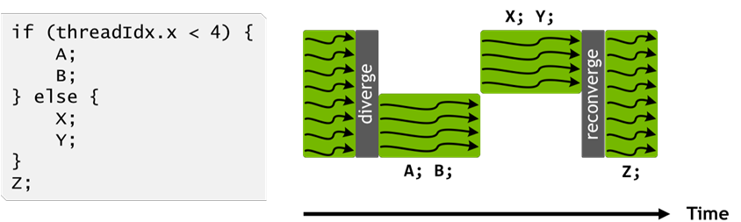
Handling thread divergence, pre-Volta (Pascal and before)
Pascal and earlier NVIDIA GPUs execute groups of 32 threads (warps) in SIMT
The Pascal warp uses a single program counter shared amongst all 32 threads, combined with an active mask that specifies which threads of the warp are active at any given time
Loss of concurrency means that threads from the same warp in divergent regions or different states of execution cannot signal each other or exchange data
This is because some threads just sit and do nothing, they’re not active
[NVIDIA]$→$

Slide 36
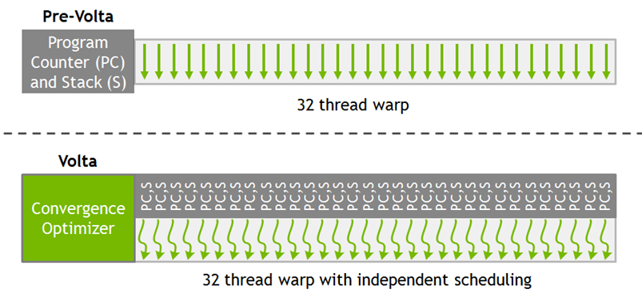
Warp Execution Model of Volta and later GPUs
Volta enables equal concurrency between all threads, regardless of warp
Volta maintains execution state (PC and S) per thread, see pic at the right
Pascal and before: one PC and S per warp
PC: program counter
S: call stack
[NVIDIA]$→$

Slide 37
The schedule optimizer
To maximize parallel efficiency, Volta includes a schedule optimizer which determines how to group active threads from the same warp together into SIMT units
Threads can now diverge and re-converge at sub-warp granularity
While the scheduler supports independent execution of threads, it optimizes non-synchronizing code to maintain as much convergence as possible
“convergence optimizer” still groups together threads that execute the same code to run them in parallel

Slide 38
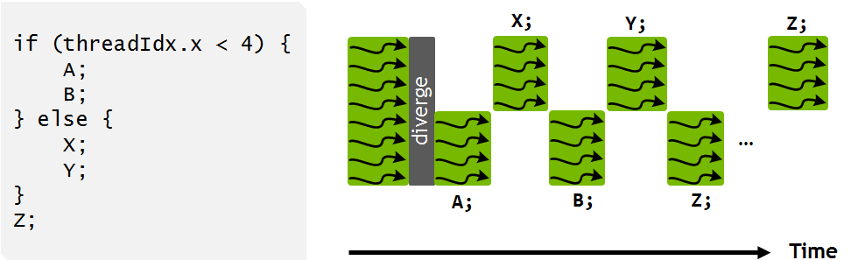
Handling thread divergence, Volta and Turing
Instructions from the if and else branches can now be interleaved in time, as shown in the pic.
NOTE: what’s shown in the pic is one possibility. How the scheduling takes place depends on the code being executed and be different than what shown in the pic
IMPORTANT: execution is still SIMT – at any given clock cycle, the same instruction is executed for all active threads in a warp just as before Volta
NOTE: this is why the “schedule optimizer” tries to converge all threads
If all converged, the 32 threads get to execute an instruction. Otherwise, only a subset of threads get to execute an instruction
Why bother with understanding this?
Ability to independently schedule threads within a warp makes it possible to implement complex, fine-grained algorithms and data structures in a more natural way
[NVIDIA]$→$

Slide 39
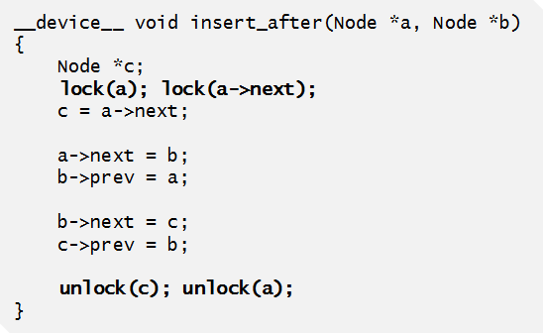
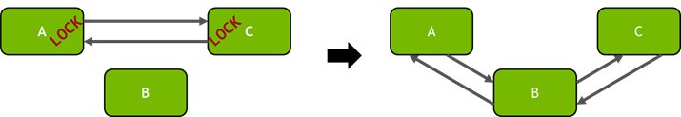
Example: Volta thread scheduling helps algorithm implementation
“Starvation-free algorithm” – a parallel algorithm that works on the presumption that a thread that participates in the implementation of the algorithm cannot be starved
NVIDIA GPUs prior to Volta: didn’t support starvation avoidance
Indeed, one or more threads may repeatedly acquire and release a mutex while starving another thread from ever successfully acquiring the mutex
Example at right shows how Volta independent thread scheduling implements a starvation-free algorithm
Inserting nodes into a doubly linked list in a multithreaded application
Per-node locks are acquired (left) before inserting node B into the list (right).
[NVIDIA]$→$
Notes:
Independent thread scheduling in Volta ensures that even if a thread T0 currently holds the lock for node A, another thread T1 in the same warp can successfully wait for the lock to become available without impeding the progress of thread T0. Note, however, that because active threads in a warp execute together, threads spinning on a lock may degrade the performance of the thread holding the lock.
It is also important to note that the use of a per-node lock in the above example is critical for performance on the GPU. Traditional doubly-linked list implementations may use a coarse- grained lock that provides exclusive access to the entire structure, rather than separately protecting individual nodes. This approach typically leads to poor performance in applications with many threads—Volta may have up to 163,840 concurrent threads—caused by extremely high contention for the lock. By using a fine-grained lock on each node, the average per-node contention in large lists will usually be low except under certain pathological node insertion patterns.

Slide 40
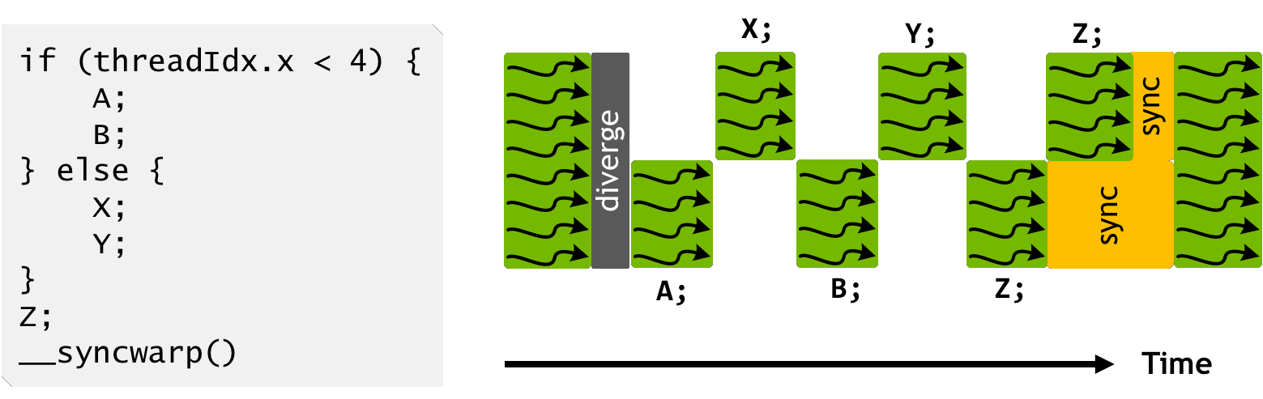
Handling thread divergence, Volta and Turing
Note that instruction Z is not executed by the same warp threads at the same time
Call CUDA 9 warp synchronization function syncwarp() to force reconvergence (lower pic)
The divergent portions of the warp might not execute Z together, but all execution pathways from threads within a warp will complete before any thread reaches the statement after the syncwarp()
Placing the call to syncwarp() before the execution of Z would force reconvergence before executing Z, potentially enabling greater SIMT efficiency if the developer knows that this is safe for their application
[NVIDIA]$→$

Slide 41
The NVIDIA GPU Memory Ecosystem

Slide 42
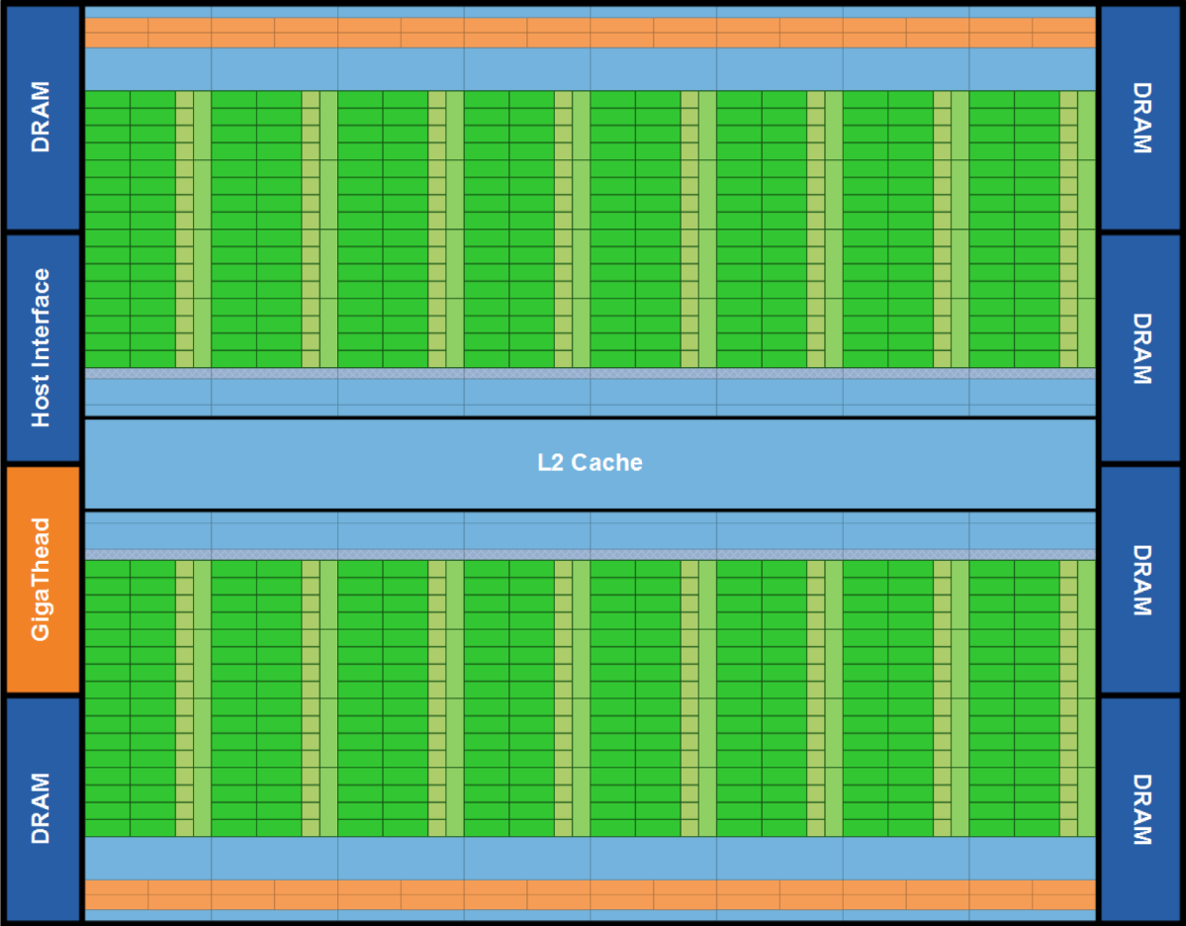
Fermi: Global Memory
Up to 6 GB of “global memory”, Kepler goes up to 12 GB, Pascal up to 16 GB, Volta up to 32 GB
“Global” in the sense that it doesn’t belong to an SM but rather all SMs can access it
Notes:
DDR5 memory blocks, external to the SMs.
SMs must “reach out” to global memory
L2 cache is also shared among all SMs. The rest of the memory hierarchy is inside each SM

Slide 43
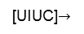
CUDA Memory Ecosystem, high vantage point [Note: picture assumes two blocks, each with two threads]
One SM
Another SM
Image shows the memory hierarchy that a block sees while running on an SM
Each thread can:
R/W per-thread registers
R/W per-thread local memory
R/W per-block shared memory
R/W per-grid global memory
Read only per-grid constant memory
Read only per-grid texture memory
(Device) Grid
Block (0, 0)
Block (1, 0)
Shared Memory
Shared Memory
Registers
Registers
Registers
Registers
Thread (0, 0)
Thread (1, 0)
Thread (0, 0)
Thread (1, 0)
Local
Memory
Local
Memory
Local
Memory
Local
Memory
Host can R/W global, constant, and texture memory
Host
Global
Memory
Constant
Memory
IMPORTANT NOTE: Global, constant, and texture memory spaces are persistent between kernels called by the same host application.
Texture
Memory
[UIUC]$→$
Notes:
Global, constant, and texture memory spaces are persistent across kernels called by the same application.

Slide 44
What “register” means in CUDA
Any variable that you are using in a kernel eats up a register or a shared memory spot
The variable that you use, it needs to “live” somewhere
For the sake of discussion, assume no shared mem variables
Then every single variable you use in a kernel will burn (at some point in the execution flow) a register
As execution advances through a kernel, the number of registers occupied keeps changing
What’s relevant: max number of registers required during the execution of the kernel

Slide 45
Programmer View of Register File
4 blocks
3 blocks
Number of 32 bit registers in one SM:
8K registers in each SM in G80
16K on Tesla
32K on Fermi
64K on Kepler and Maxwell and Pascal and Volta
Registers are dynamically partitioned across all Blocks assigned to the SM
Once assigned to a Block, these registers are NOT accessible by threads in other Blocks
A thread in a Block can only access registers assigned to itself
IMPORTANT: A thread can have assigned by the compiler up to 255 registers
Possible per-block partitioning scenarios of the RF available on the SM

Slide 46
Register related: a “level of parsimony” issue
Size of a register: 4 bytes
Is it that if you use a char in a kernel, then you don’t use a full register but rather ¼ of it?
Not really, unfortunately; i.e., there is no parsimony in usage of a register
Any data type that requires less then or equal to 4 bytes eats up a register
One char thus eats up an entire register
If you use a double, it eats up two registers
Notes:
See also https://devtalk.nvidia.com/default/topic/491309/int-vs-short-vs-char-in-kernels/

Slide 47
The Concept of Local Memory [“local”: misnomer]
(Device) Grid
Local memory does not physically exist
Data stored in “local memory” is actually placed in cache or the global memory at run time or by the compiler
If too many registers are needed for computation (“high register pressure”) the ensuing data overflow is stored in local memory
“Local” means that it’s got local scope; i.e., it’s specific to one thread and not visible to any other thread
Long access times for local memory unless cached
Block (0, 0)
Block (1, 0)
Shared Memory
Shared Memory
Registers
Registers
Registers
Registers
Thread (0, 0)
Thread (1, 0)
Thread (0, 0)
Thread (1, 0)
Local
Memory
Local
Memory
Local
Memory
Local
Memory
Host
Global
Memory
Constant
Memory
Texture
Memory
Notes:
Global, constant, and texture memory spaces are persistent across kernels called by the same application.

Slide 48

Caches & the Shared Memory
Fermi
Each SM: 64 KB L1 cache & shared memory
All SMs tap into a common 768 KB L2 cache memory
Pascal:
Each SM: Unified 24 KB L1 cache
Each SM: 64 KB shared memory
All SMs tap into 4096 KB of L2 cache memory
Volta:
L1 cache + Shared Mem = 128 KB per SM
One can carve out of 128KB shared memory as follows:
0 KB, 8 KB, 16 KB, 32 KB, 64 KB, or 96 KB
What is not taken by the ShMem becomes L1 cache:
128 KB, 120 KB, 112 KB, 96 KB, 64 KB, 32 KB
All SMs tap into 6144 KB of L2 cache memory
IMPORTANT: Numbers reported are per SM
Fermi SM
Notes:
The previous plot is bandwidth for moving data from/to global memory.
Each SM has local L1 cache (shared with shared memory, ratio under user control).
Fermi default: 48 KB shared / 16 KB L1 cache (can also do16/48)
Kepler: 48/16, 32/32, 16/48
Difference: shared memory is controlled by the user. L1 cache use is automatic. If you do not use shared memory, increase the chunk for L1 cache to allow the hardware to leverage it.

Slide 49
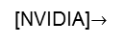
Global, Constant, and Texture Memories
Global memory
Main means of communicating R/W Data between host and device
Contents visible to all threads
Texture and Constant Memories
Constants initialized by host
Contents visible to all threads
Global, texture and constant memories are accessible by host
Done at high latency, low bandwidth
(Device) Grid
Block (0, 0)
Block (1, 0)
Shared Memory
Shared Memory
Registers
Registers
Registers
Registers
Thread (0, 0)
Thread (1, 0)
Thread (0, 0)
Thread (1, 0)
Local
Memory
Local
Memory
Local
Memory
Local
Memory
Host
Global
Memory
Constant
Memory
NOTE: We will not emphasize texture in ME759.
Texture
Memory
[NVIDIA]$→$

Slide 50
Memory Access Times
Register – dedicated HW - single cycle
Shared Memory – dedicated HW – a few cycles
Local Memory – DRAM, (if not in cache - *slow*; if cached – relatively fast)
Global Memory – DRAM, no cache - *slow*; cached, is fast…
Constant Memory – DRAM, cached, 10s…100s of cycles, depending on cache locality
Texture Memory – DRAM, cached, 10s…100s of cycles, depending on cache locality
Instruction Memory (invisible) – DRAM, cached
Notes:
Take away message: organize your code to use as much as possible the faster memory:
keep in mind the relative access times (some of these change with new hardware)
be careful how you organize data and what data you bring over (do not duplicate information)
Recall:
GPUs have much larger register files than a CPU
64K registers (each one word, i.e. 32 bits) per SM on Pascal
But you can also have up to 2048 threads resident per SM
So you end up with just 32 registers per thread!
In fact, NVIDIA sets an upper limit of 255 registers/thread

Slide 51
Storage Locations
Memory | Location | Cached | Access | Who
Register | On-chip | N/A | Read/write | One thread only
Shared | On-chip | N/A | Read/write | All threads in a block
Global | Off-chip | Yes | Read/write | All threads + host
Constant | Off-chip | Yes | Read | All threads + host
Texture | Off-chip | Yes | Read | All threads + host
Off-chip means on the GPU but not on the SM, which translates into high latency.
Notes:
Back in the day (Tesla C1060): global memory was not cached

Slide 52
Putting things in perspective: The 3 most important GPU memory spaces
Thread
Register: per-thread basis
Private per thread
Can spill into local memory (potential performance hit unless cached)
Shared Memory: per-block basis
Shared by threads of the same block
Used for: intra-block inter-thread communication
Global Memory: per-application basis
Available for use by all threads
Used for: global access, all threads
Also used for inter-grid communication
Register
Block
Shared
Memory
Grid 0
Global
Memory
. . .
Sequential
Grids
in Time
Grid 1
. . .

Slide 53
Example: Matrix Multiplication, Revisited
Purpose
See an example where the use of multiple blocks of threads plays a central role
Highlight the use/role of the shared memory
Point out the __syncthreads() function call
NOTE: A one dimensional array stores the entries in the matrix
Notes:
Here we will use a bus instead of a bunch of cars to bring over data from memory.
Savings come from the fact that bandwidth to accessing shared memory is ~10 better than global memory.
Thread synchronization becomes crucial to avoid race conditions

Slide 54
A Critique of the Old Matrix Multiplication Example
One row of M is loaded N.width times
This happens for each row of M
Moral of the story: the matrix M is loaded N.width times
One column of N is loaded M.height times
This happens for each column of N
Moral of the story: the matrix N is loaded M.height times
Loading M and N over and over → not a good idea, memory transactions are expensive
Grid 1
N
Block 1
Thread
(2, 2)
48
M
P
width

Slide 55
Why Revisit the Old Example?
In the naïve first implementation the ratio of arithmetic computation to memory transaction (“arithmetic intensity”) very low
Each arithmetic computation required one fetch from global memory
The entries in M are copied from global memory to the device N.width times
The entries in N are copied from global memory to the device M.height times
No brownie points for moving data around
Hundreds of cycles required for bringing data from global memory
When solving a problem the goal is to go through the machine instructions in your executable, not to wait for data to come your way
Notes:
Data reuse is the goal

Slide 56
How to answer an important question: “Could I use Shared Memory?”
Imagine you are a thread executing the kernel
The ShMem test: If data that you, as a thread, use can also be used by another thread in your block, then you should consider using shared memory
Note: regardless of the above test, you can use shared memory as scratch pad memory
Don’t let it go wasted, use for storing often-used variables even if they’re not used by multiple threads

Slide 57
A Common CUDA Programming Pattern: Tiling w/ Shared Memory
Global memory access - much slower when compared to shared memory access
No brainer: Use shared memory, if at all possible
Partition data into data subsets (tiles) that each fits into shared memory
Handle each data subset (tile) with one thread block by:
Loading the tile from global memory into shared memory, using multiple threads to exploit memory-level parallelism
Performing the computation on the tile from shared memory; each thread can efficiently multi-pass over any data element of the tile
Notes:
Recall: global memory: DRAM Shared memory: SRAM (split with L1 - Fermi or dedicated - Pascal)
Focus on data reuse
Introduce the concept of tiling (common programming pattern)

Slide 58
Tiling used for Matrix-Matrix multiplication
tx
One block computes one square sub-matrix C_{sub} of size Block_Size
B
Block_Size
One thread computes one entry of C_{sub}
Assumption: A and B are square matrices and their dimensions of are multiples of Block_Size
Doesn’t have to be like this, but keeps example simpler and focused on the concepts of interest
In this example work with Block_Size=16x16
wA
Block_Size
A
C
C_{sub}
Block_Size
hA
ty
Block_Size
Block_Size
Block_Size
wA
wB
NOTE: A similar technique is used on CPUs to improve cache hits. See slide “Blocking Example” at
http://cseweb.ucsd.edu/classes/fa10/cse240a/pdf/08/CSE240A-MBT-L15-Cache.ppt.pdf
Notes:
We will have a first loop over tiles (moving left in A, moving down in B)
Then, inside a tile (i.e. a block), each thread will loop over a row in the A tile and a column in the B tile to calculate a piece of its final value (the red square in C)

Slide 59
A Block of 16 X 16 Threads
Notes:
We will have 256 (16x16) threads that will work in concert on a tile
They will bring together (in shared memory) one tile from A and one tile from B
Then, they each work separately on calculating an increment for their assigned C[i,j]
But they do so by sharing data!

Slide 60
// Thread block size
#define BLOCK_SIZE 16
// Forward declaration of the device multiplication func.
__global__ void Muld(float*, float*, int, int, float*);
// Host multiplication function
// Compute C = A * B
// hA is the height of A
// wA is the width of A
// wB is the width of B
void Mul(const float* A,const float* B,int hA,int wA,int wB, float* C)
{
// Load A and B to the device
float* Ad;
int size = hA * wA * sizeof(float);
cudaMalloc((void**)&Ad, size);
cudaMemcpy(Ad, A, size, cudaMemcpyHostToDevice);
float* Bd;
size = wA * wB * sizeof(float);
cudaMalloc((void**)&Bd, size);
cudaMemcpy(Bd, B, size, cudaMemcpyHostToDevice);
// Allocate C on the device
float* Cd;
size = hA * wB * sizeof(float);
cudaMalloc((void**)&Cd, size);
// Compute the execution configuration *assuming*
// the matrix dimensions are multiples of BLOCK_SIZE
dim3 dimBlock(BLOCK_SIZE, BLOCK_SIZE);
dim3 dimGrid( wB/dimBlock.x , hA/dimBlock.y );
// Launch the device computation
Muld<<<dimGrid, dimBlock>>>(Ad,Bd,wA,wB,Cd);
// Read C from the device
cudaMemcpy(C, Cd, size, cudaMemcpyDeviceToHost);
// Free device memory
cudaFree(Ad);
cudaFree(Bd);
cudaFree(Cd);
}
Notes:
Execution configuration:
blocks must all have 16x16 = 256 threads (take advantage of 2D layout)
how many blocks do we need? simple under our assumption that the matrix dimensions are multiples of the tile size
if not, more complicated (some tiles will “fall off” the matrix extent) this is messy and main part of frustration in CUDA computing

Slide 61
Notes:
bx = blockIdx.x the B (and C) matrix sub-block column index
by = blockIdx.y the A (and C) matrix sub-block row index
aBegin = wA * (by*BLOCK_SIZE) index of the first sub-matrix of A processed by the block
aEnd = aBegin + wA – 1
aStep = BLOCK_SIZE
bBegin = BLOCK_SIZE * bx;
bStep = BLOCK_SIZE * wB

Slide 62
// Shared memory for the sub-matrices (tiles) of A and B
__shared__ float As[BLOCK_SIZE][BLOCK_SIZE];
__shared__ float Bs[BLOCK_SIZE][BLOCK_SIZE];
// Loop over all the sub-matrices (tiles) of A and B required to
// compute the block sub-matrix; moving in A left to right in
// a row, and in B from top to bottom in a column
for (int a = aBegin, b = bBegin;
a <= aEnd;
a += aStep, b += bStep) {
// Load tiles from global memory into shared memory; each
// thread loads one element of the two tiles from A & B
As[ty][tx] = A[a + wA * ty + tx];
Bs[ty][tx] = B[b + wB * ty + tx];
// Synchronize to make sure the matrices are loaded
__syncthreads();
// Each thread in this block computes one element
// of the block sub-matrix (tile). Thread with indexes
// ty and tx computes in this tile the entry [ty][tx].
for (int k = 0; k < BLOCK_SIZE; ++k)
Csub += As[ty][k] * Bs[k][tx];
// Synchronize to make sure that the preceding
// computation is done before loading two new
// sub-matrices of A and B in the next iteration
__syncthreads();
}
// Write the block sub-matrix to global memory;
// each thread writes one element
int c = wB * BLOCK_SIZE * by + BLOCK_SIZE * bx;
C[c + wB * ty + tx] = Csub;
}
// Device multiplication function called by Mul()
// Compute C = A * B
// wA is the width of A
// wB is the width of B
__global__ void Muld(float* A, float* B, int wA, int wB, float* C)
{
// Block index
int bx = blockIdx.x; //the B (and C) matrix sub-block column index
int by = blockIdx.y; //the A (and C) matrix sub-block row index
// Thread index
int tx = threadIdx.x; //the column index in the sub-block
int ty = threadIdx.y; //the row index in the sub-block
// Index of the first sub-matrix of A processed by the block
int aBegin = wA * BLOCK_SIZE * by;
// Index of the last sub-matrix of A processed by the block
int aEnd = aBegin + wA - 1;
// Step size used to iterate through the sub-matrices of A
int aStep = BLOCK_SIZE;
// Index of the first sub-matrix of B processed by the block
int bBegin = BLOCK_SIZE * bx;
// Step size used to iterate through the sub-matrices of B
int bStep = BLOCK_SIZE * wB;
// The element of the block sub-matrix that is computed
// by the thread
float Csub = 0;
Notes:
if __shared__ does not appear: each thread sets aside 16x16 memory locations for As and 16x16 for Bs
that’s already double what could ever be in registers → spills to local memory
with __shared__ this memory is specific to the block and shared between all threads in the block!
attention: all threads bring over disjoint pieces of data
Why do we need the __syncthreads here? Only threads in the same warp proceed in lock-step fashion. But threads in different warps do not.
Who gets synchronized? Threads in the same block
Would it make sense to have a Cs in shared memory? No – recall the “test for using shared memory”; no other thread needs this information

Slide 63
Synchronization Function
Synchronization accomplished through a device lightweight function
void __syncthreads();
Synchronizes all threads in a block (acts as barrier for all block threads)
Does not synchronize threads from two blocks
One more condition for execution to commence once all threads in a block reached the sync point:
All global & shared mem. transactions made by these threads prior to __syncthreads() are visible to all block threads
Used to avoid RAW/WAR/WAW hazards when accessing shared or global memory (more later)
Notes:
Attention: do not put a __syncthreads in an if statement unless you can guarantee all threads in the block go through there!

Slide 64
[warning] __syncthreads() & thread divergence
#include<cuda.h>
#include<iostream>
__global__ void badIdeaSynchronization(int* data)
{
int i = threadIdx.x + blockDim.x * blockIdx.x;
if ((i & 0x01) == 0)
{
data[i] = data[i] + i; // if not odd, come here
}
else
{
data[i] = data[i] + 2 * i; // come here if you're odd
__syncthreads();
}
}
int main()
{
const int numElems = 4;
int hostArray[numElems], *devArray;
//allocate memory on the device (GPU); zero out all entries in this device array
cudaMalloc((void**)&devArray, sizeof(int) * numElems);
cudaMemset(devArray, 0, numElems * sizeof(int));
//invoke GPU kernel, with one block that has four threads
hangs<<<1, numElems >>>(devArray);
//bring the result back from the GPU into the hostArray
cudaMemcpy(&hostArray, devArray, sizeof(int) * numElems, cudaMemcpyDeviceToHost);
//print out the result to confirm that things are looking good
std::cout << "Values stored in hostArray: " << std::endl;
for (int i = 0; i < numElems; i++)
std::cout << hostArray[i] << std::endl;
//release the memory allocated on the GPU
cudaFree(devArray);
return 0;
}
Be very cautious when using a __syncthreads() in a conditional
The actual behavior is not clear
Some difference between the Programming Guide and what happens in reality
See here for discussion of how/when code deadlocks:
https://stackoverflow.com/questions/6666382/can-i-use-syncthreads-after-having-dropped-threads
https://stackoverflow.com/questions/15146886/conditional-syncthreads-deadlock-or-not

Slide 65
3 Ways to Set Aside Shared Memory
First way: Statically, declared inside a kernel
See matrix multiplication example w/ shared memory use
Second way: Through the execution configuration
Ns below indicates size (in bytes) to be allocated in shared memory
__global__ void MyFunc(float*) // __device__ or __global__ function
{
extern __shared__ float shMemArray[];
// Size of shMemArray determined through the execution configuration
// You can use shMemArray as you wish here…
}
// invoke like this
MyFunc<<< Dg, Db, Ns >>>(parameter);
Third way: Dynamically, via CUDA Driver API
Advanced feature, uses API function cuFuncSetSharedSize(), not discussed here

Slide 66
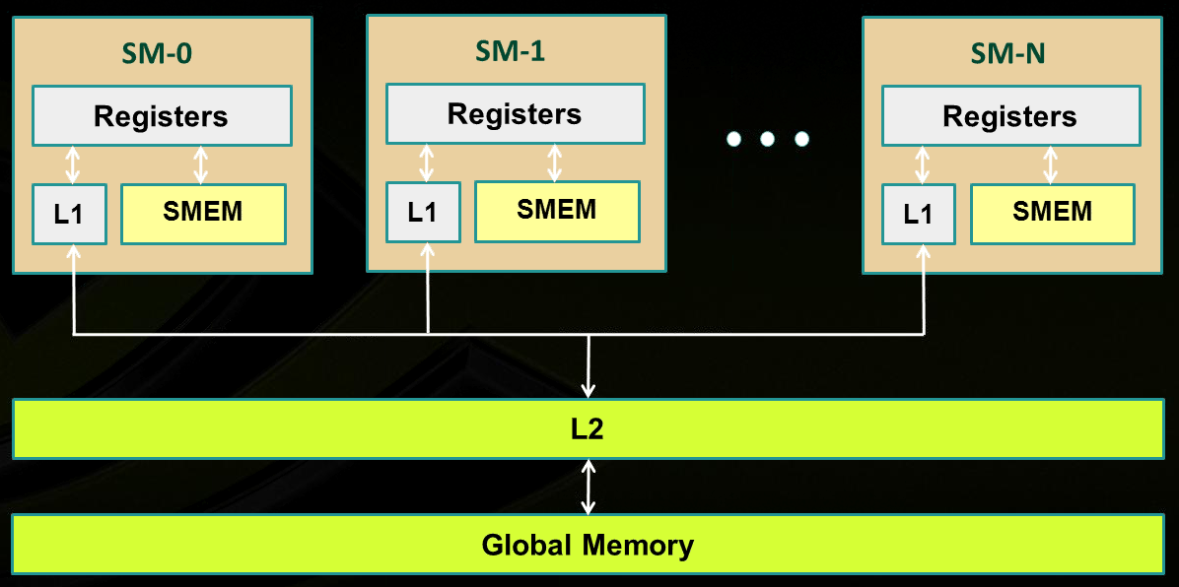
Memory Layout, Fermi and more recent architectures
SM₀
SM₁
SM_{N-1}
NVIDIA→
Notes:
Illustration of caches intermediating global memory access.
Recall: shared memory is not cached

Slide 67
GPU Cache Line
All global memory accesses are cached
A cache line is 128 bytes
It maps to a 128-byte aligned segment in device memory
Note: it so happens that 128 bytes = 32 (warp size) * 4 bytes
In other words, 32 floats or 32 ints fit in one cache line (and can be brought in L2 or L1 in one trip)
If the size of the type accessed by each thread is more than 4 bytes, a memory request by a warp is first split into separate 128-byte memory requests that are issued independently
Notes:
What is important about a cache line of 128 bytes?
it maps well in a data transaction for an entire warp: 32 floats or 32 ints
in one operation services all threads in a warp
You can determine at *compile* time (through flags: -dlcm=ca/cg) if you double cache [L1 & L2] or only cache [L2 only]
If [L1 & L2], a memory access is serviced with a 128-byte memory transaction
If [L2 only], a memory access is serviced with a 32-byte memory transaction
This can reduce over-fetch in the case of scattered memory accesses
Good for irregular pattern access (sparse linear algebra)

Slide 68
L1 & L2 Cache Issues [two slide detour – 1/2]
L1 and L2 cache used to cache accesses to
Local memory
Global memory
L2 cache (Volta): 6144 KB – one big pool available to *all* SMs on the device
Whether reads are cached in [L1 & L2] or in [L2 only] can be partially configured on a per-access basis using modifiers to the load or store instruction
Notes:
Recalling some numbers for a particular card (Fermi).
On all recent cards, all memory transactions are intermediated by the cache.
Size of cache line: 128 bytes
You can determine at *compile* time (through flags: -dlcm=ca/cg) if you double cache [L1 & L2] or only cache [L2 only]
If [L1 & L2], a memory access is serviced with a 128-byte memory transaction
If [L2 only], a memory access is serviced with a 32-byte memory transaction
This can reduce over-fetch in the case of scattered memory accesses
Good for irregular pattern access (sparse linear algebra)

Slide 69
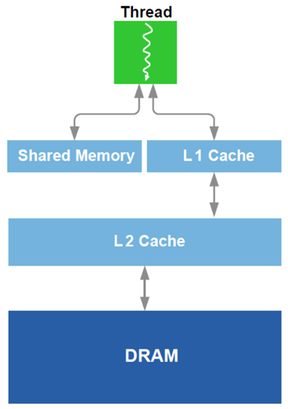
L1 Cache vs. Shared Memory [two slide detour – 2/2]
Starting w/ Fermi architecture, you can split some fast memory between shared memory and cache
Example, Fermi: you can go 48/16 or 16/48 KB for Shared Mem/Cache
OPTION 1: you choose to go w/ “Lots of Cache & Little Shared Mem”
Cache handled for you by the scheduler
No control over it
Can’t have too many blocks of threads running if blocks use Shared Mem
OPTION 2: you choose to go w/ “Lots of Shared Mem & Little Cache”
Good in tiling, you have full control
Shared Mem pretty cumbersome to manage
Notes:
On Maxwell and Pascal, dedicated shared memory (64) and unified L1 cache (24), per SM
Pre-Pascal, the L1 cache / ShMem split can be done at runtime, or through compiler option
One last note about specifying use of shared memory for a block:
statically, declared in the kernel function using the keyword __shared__ like we did before
specify requirements through the execution configuration: __global__ void my_kernel(…) { extern __shared__ float As[]; // size is Ns bytes … } my_kernel<<< grid_dim , block_dim , Ns >>> (…);
dynamically, through the CUDA driver API (low-level) cuFuncSetSharedSize();
Note: as of Fermi, no direct access to shared memory. May need to use volatile to prevent the compiler from optimizing by using registers! Not needed here because __syncthreads already has memory-fencing built-in (i.e. the registers are evicted back to shared memory at that point)

Slide 70
On the architecture of the GPU’s Shared Memory [1/2]
GPU computing: many threads access the ShMem at the same time
To service more than one thread, ShMem is divided into independent banks
This layout essential to achieve high bandwidth
Each SM has ShMem organized in 32 Memory banks
Successive 32-bit words map to successive banks
Each bank has a bandwidth of 32 bits per clock cycle
Bank 0
Bank 1
Bank 2
Bank 3
Bank 4
Bank 5
Bank 6
Bank 7
Bank 31

Slide 71
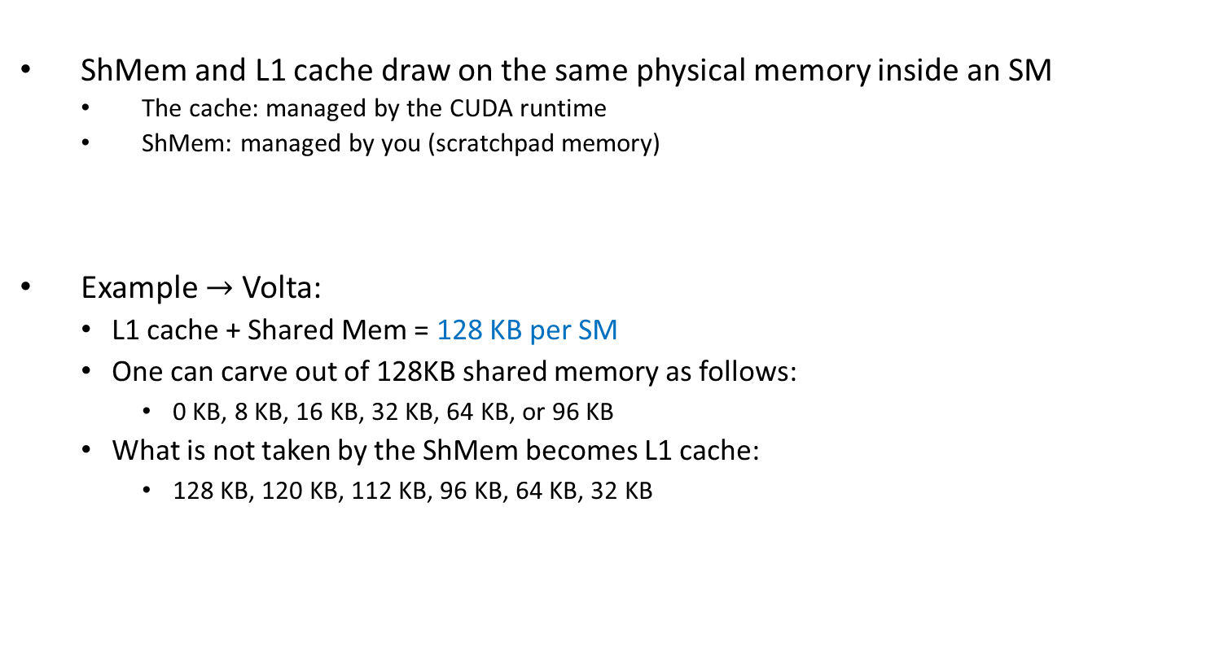
On the architecture of the GPU’s Shared Memory [1/2]
ShMem and L1 cache draw on the same physical memory inside an SM
The cache: managed by the CUDA runtime
ShMem: managed by you (scratchpad memory)
Example $→$ Volta:
L1 cache + Shared Mem = 128 KB per SM
One can carve out of 128KB shared memory as follows:
0 KB, 8 KB, 16 KB, 32 KB, 64 KB, or 96 KB
What is not taken by the ShMem becomes L1 cache:
128 KB, 120 KB, 112 KB, 96 KB, 64 KB, 32 KB
Bank 0
Bank 1
Bank 2
Bank 3
Bank 4
Bank 5
Bank 6
Bank 7
Bank 31

Slide 72
On the architecture of the GPU’s Shared Memory [2/2]
The 32 ShMem banks organized like benches in a movie theater
You have multiple rows of benches
Each row has 32 benches separated; each bench belongs to a long column
A bank: a column of benches in the movie theater, perpendicular to screen
In each bench you can “seat” a family of four bytes (32 bits total)
Each bank has a bandwidth of 32 bits per two clock cycles
I
$
There are 32 columns of benches (banks);
each column is very deep (many benches)
L
1
Bank 0
Multithreaded
Bank 1
Instruction Buffer
Bank 2
Bank 3
screen of the movie theater
Bank 4
R
D
$
Shared
Bank 5
F
L
1
Mem
Bank 6
Bank 7
Operand Select
Bank 31
MAD
SFU

Slide 73
Shared Memory: Transaction Rules & Bank Conflicts
When reading in four-byte words, 32 threads in a warp attempt to access shared memory simultaneously
Bank conflict: two different threads access *different* words in different rows of the same bank
Note that there is no conflict if different threads access any bytes within the same word (same row)
Bank conflicts enforce the hardware to serialize a ShMem access, which adversely impacts bandwidth

Slide 74
Shared Memory Bank Conflicts
If there are no bank conflicts:
Shared memory access is fast, but not as fast as register access
On the bright side, latency is roughly 100x lower than global memory latency
ShMem operation, the fast case:
If all threads of a warp access different banks, there is no bank conflict
If all threads of a warp access an identical address for a fetch operation, there is no bank conflict (broadcast)
ShMem memory operation, the slow case:
Worst case: 32 threads access 32 different words in the same bank
Must serialize all the accesses
In general, cost = max # of simultaneous accesses to a single bank

Slide 75
Example: How Addresses Map to Banks, for array of float
An allotted chunk of shared memory starts at an address that is at least a multiple of 128 (if not 256)
Bank you work with = (address of offset) % 32
Example: 1D shared mem array, myShMemVar, of 1024 floats
myShMemVar[4]: accesses bank #4 (physically, the fifth one – first row)
myShMemVar[31]: accesses bank #31 (physically, the last one – first row)
myShMemVar[50]: access bank #18 (physically, the 19th one – second row)
myShMemVar[128]: access bank #0 (physically, the first one – fifth row)
myShMemVar[178]: access bank #18 (physically, the 19th one – sixth row)
If, for instance, the third thread in a warp accesses myShMemVar[50] and the eight thread in the warp accesses myShMemVar[178], then you have a two-way bank conflict and the two transactions get serialized
IMPORTANT: There is no such thing as “bank conflicts” between threads belonging to different warps

Slide 76
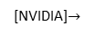
Bank Addressing Examples Transactions Involving 4 Byte Words
No Bank Conflicts
Linear addressing stride == 1
No Bank Conflicts
Random 1:1 Permutation
Thread 0
Bank 0
Thread 0
Bank 0
Thread 1
Bank 1
Thread 1
Bank 1
Thread 2
Bank 2
Thread 2
Bank 2
Thread 3
Bank 3
Thread 3
Bank 3
Thread 4
Bank 4
Thread 4
Bank 4
Thread 5
Bank 5
Thread 5
Bank 5
Thread 6
Bank 6
Thread 6
Bank 6
Thread 7
Bank 7
Thread 7
Bank 7
Thread 31
Bank 31
Thread 31
Bank 31
[NVIDIA]$→$

Slide 77
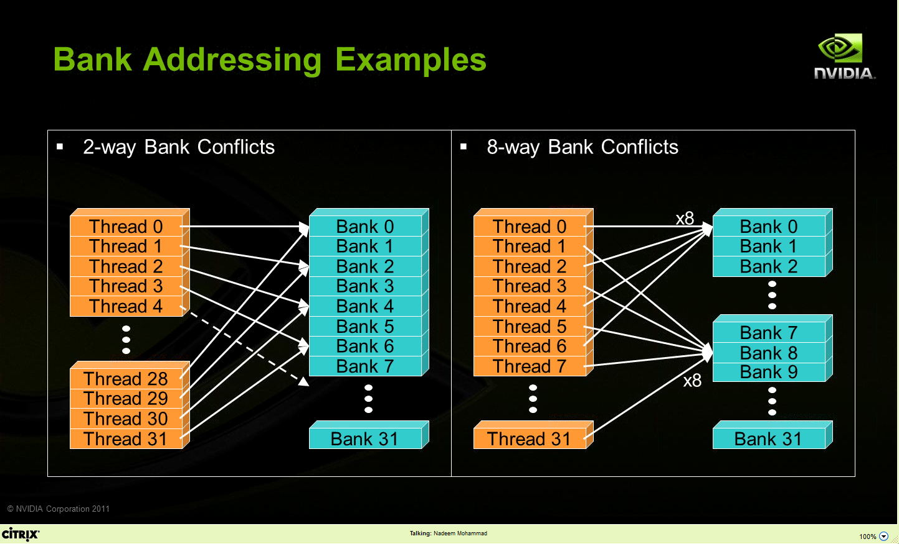
Bank Addressing Examples Transactions Involving 4 Byte Words
A case in which only the even banks end up being accessed, and the warps access different words in each bank
A case in which the 32 threads in a warp access only banks 0, 8, 16, and 24 (and different words in these four banks)
[NVIDIA]$→$

Slide 78
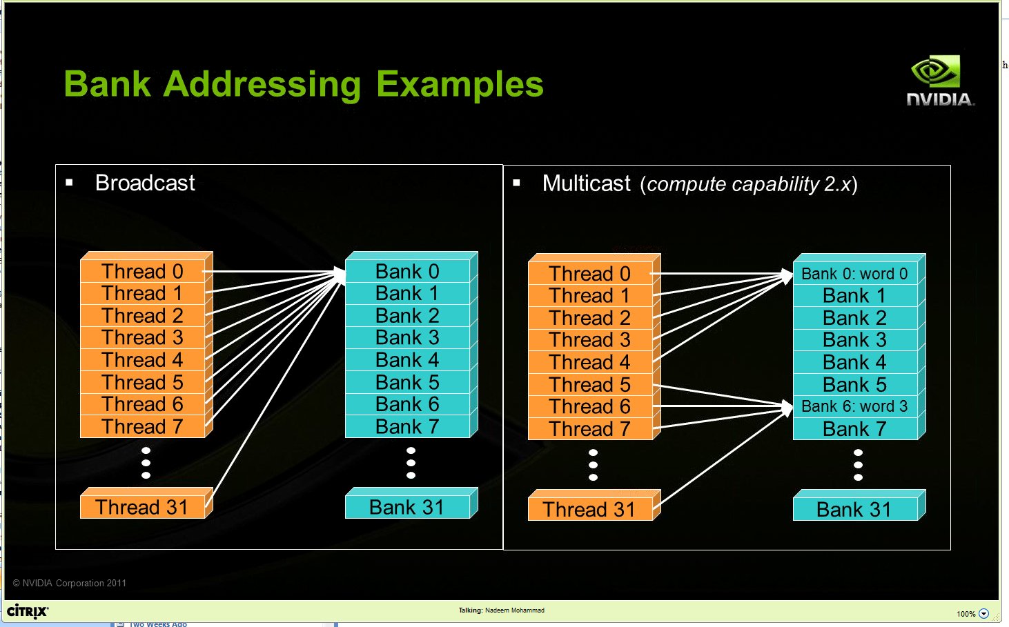
Other Examples
Two “no conflict” scenarios, reading operations:
Broadcast: all threads in a warp access the same word in a bank
Multicast: several threads in a warp access the same word in the same bank

Slide 79
Linear Addressing
Given:
__shared__ float sharedM[256];
float foo = sharedM[baseIndex + s * threadIdx.x];
This is bank-conflict-free if s shares no common factors with the number of banks
Conclusion: you are fine if s is odd
s=1
s=3
Thread 0
Bank 0
Thread 0
Bank 0
Thread 1
Bank 1
Thread 1
Bank 1
Thread 2
Bank 2
Thread 2
Bank 2
Thread 3
Bank 3
Thread 3
Bank 3
Thread 4
Bank 4
Thread 4
Bank 4
Thread 5
Bank 5
Thread 5
Bank 5
Thread 6
Bank 6
Thread 6
Bank 6
Thread 7
Bank 7
Thread 7
Bank 7
Thread 31
Bank 31
Thread 31
Bank 31
Note: baseIndex assumed 0 (zero) in these two pics

Slide 80
Data types and bank conflicts
Below, no conflicts if shrd is a 32-bit data type:
foo = shrd[baseIndex + threadIdx.x]
Also if accessing one byte-per-thread, no conflict since *different* bytes of the same word are accessed
No conflicts:
extern __shared__ char shrd[];
foo = shrd[baseIndex + threadIdx.x];
No conflicts:
extern __shared__ short shrd[];
foo = shrd[baseIndex + threadIdx.x];
Thread 0
Bank 0
Thread 1
Bank 1
Thread 2
Bank 2
Thread 3
Bank 3
Thread 4
Bank 4
Thread 5
Bank 5
Thread 6
Bank 6
Thread 7
Bank 7
Thread 31
Bank 31
Thread 0
Bank 0
Thread 1
Bank 1
Thread 2
Bank 2
Thread 3
Bank 3
Thread 4
Bank 4
Thread 5
Bank 5
Thread 6
Bank 6
Thread 7
Bank 7
Thread 31
Bank 31

Slide 81
Exercise: Is ShMem access below good or bad?
Snippet from a kernel, each thread loads two floats into ShMem:
This makes sense for traditional CPU threads, locality in cache line usage and reduced sharing traffic
Doesn’t make sense in shared memory usage where there is no cache line effects but banking effects
2-way-interleaved loads result in 2-way bank conflicts
Adding insult to injury: you don’t have coalesced global memory loads – basically you are halving the device mem bandwidth (more on this later)
int tid = threadIdx.x;
shared[2*tid ] = global[2*tid ];
shared[2*tid+1] = global[2*tid+1];
Thread 0
Bank 0
Thread 1
Bank 1
Thread 2
Bank 2
Thread 3
Bank 3
Bank 4
Bank 5
Bank 6
Bank 7
Thread 16
Thread 17
Thread 18
Thread 19
Bank 31
Notes:
What is “cache line effects”?

Slide 82
A better array access pattern: Revisiting example on previous slide
Thread 0
Bank 0
Here’s a better way of doing it
Each thread loads one element in every consecutive group of blockDim elements.
Thread 1
Bank 1
Thread 2
Bank 2
Thread 3
Bank 3
shared[tid] = global[tid];
shared[tid + blockDim.x] = global[tid + blockDim.x];
Thread 4
Bank 4
Thread 5
Bank 5
Thread 6
Bank 6
Thread 7
Bank 7
Thread 31
Bank 31

